Slide 2
IMS overview
What is IMS ?
IMS is system.
An architectural framework for delivering IP multimedia services across roaming boundaries and over diverse access technologies.

Slide 3
IMS overview
Why should we have IMS?
The answer is threefold:
QoS (Quality of Service).
Charging.
Integration of different services.

Slide 4
IMS overview
Why should we have IMS?
Don’t care about kind of terminals (wifi, WAN, 3G,4G,5G,PSTN,…) and services.
→ Because application servers and terminals layer are not in the IMS.

Slide 5
IMS overview
What is IMS architecture?
IMS architecture is a collection of functions linked by standardized interfaces.
IMS architecture include 3 main layer :
Application Server layer (AS).
Control / IMS layer.
Transport layer.

Slide 6
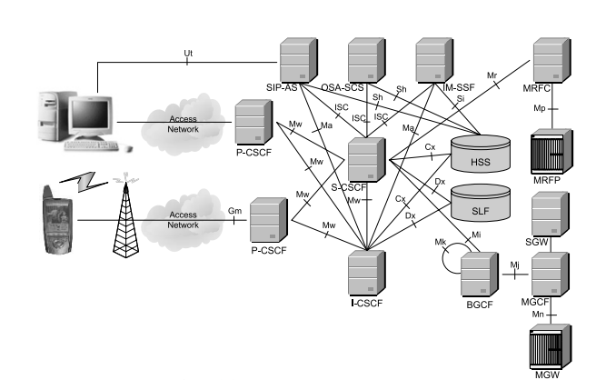
AS layer
Control / IMS layer

Slide 7
Ims overview
Which nodes the IMS network include?
One or more user databases, called HSSs and SLFs
One or more SIP servers as CSCFs (Call Session Control Function)
One or more ASes (Application Server)
One or more MRFs inlude: MRFCs and MRFPs

Slide 8
Ims overview
Which nodes the IMS network include?
One or more BGCFs
One or more PSTN gateways inlude SGW and MGW.

Slide 9
DATABASE

Slide 10
Database
HSS
SLF

Slide 11





HSS (Home Subscriber server)
Database for IMS
User’s location
Contain user information
User’s registration
Preferences

Slide 12



HSS
Sessions
establish
provide
Information
In Database
Services

Slide 13
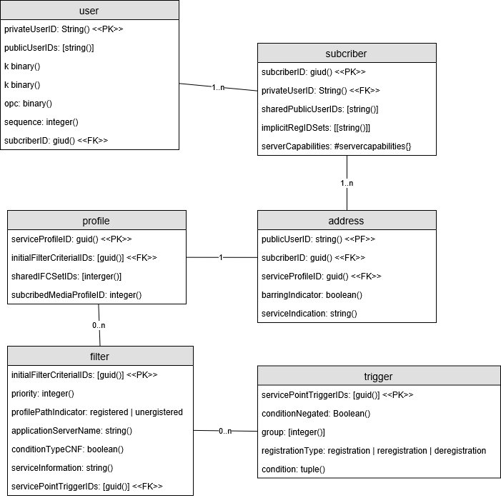
HSS
Sample database schema

Slide 14
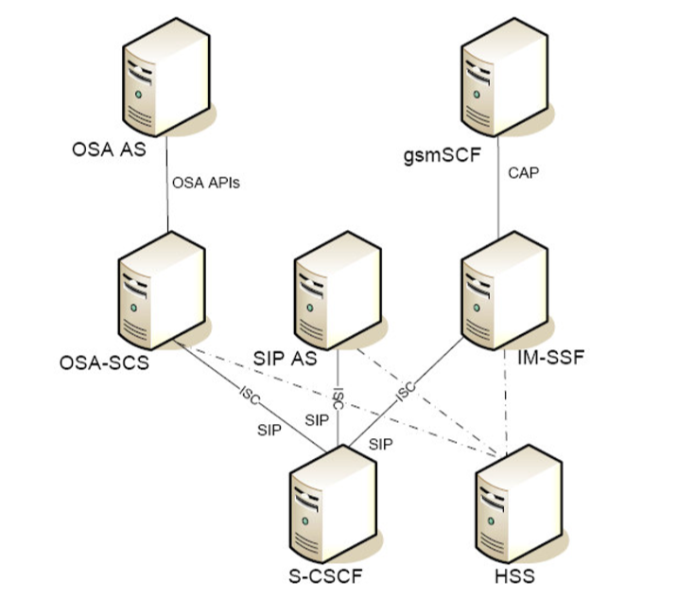
HSS location

Slide 15
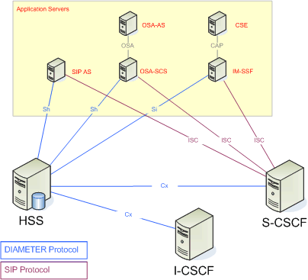
HSS Interfaces
Connection between HSS and other network entities

Slide 16

SLF Subscription locator function
Simple database
Map user’s address to HSS
Only use if have more than one HSS

Slide 17
CSCF

Slide 18
CSCf - call session control function
What is CSCF?
CSCF used to handle SIP signal in the IMS.
Comprises three distinct roles:
The Proxy-CSCF (P-CSCF),
The Interrogating-CSCF (I-CSCF)
The Serving-CSCF (S-CSCF).

Slide 19
CSCf - call session control function
The proxy-cscf (p-cscf)

Slide 20
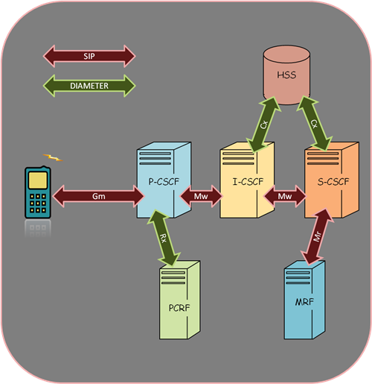

Slide 21
call session control function
The Proxy-CSCF (P-CSCF):
1/ Establishing the IPSec Security Association (SA) with UE (User Equipment)

Slide 22
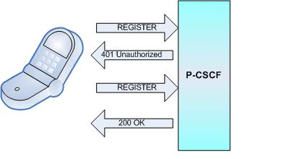

Slide 23
call session control function
The Proxy-CSCF (P-CSCF):
2/ Compress and decompress the SIP messages on the air interface

Slide 24
call session control function
The Proxy-CSCF (P-CSCF):
3/ Providing information for billing and policy control

Slide 25
call session control function
The Proxy-CSCF (P-CSCF):
4/ Identifying emergency calls.

Slide 26
CSCf - call session control function
A interrogating-cscf (i-cscf)

Slide 27
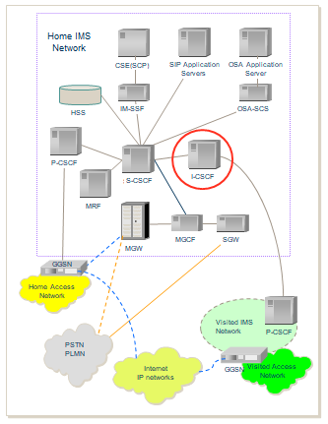
CSCf - call session control function
An Interrogating-CSCF (I-CSCF):
I-CSCF is a SIP proxy.
The address of I-CSCF is stored in DNS records.
It also communicates with HSS.
Notes:
When you send a SIP message to a specific domain, it looks up DNS to obtain the SIP server address of that domain.
It also communicates with HSS to get user location information and sent SIP message to appropriate destination (typically an S-CSCF). In contrast, I-CSCF will reply SIP message to an S-CSCF / I-CSCF within the network of another service provider.

Slide 28
CSCf - call session control function
An Interrogating-CSCF (I-CSCF):
I-CSCF can encrypt a part of SIP messages (THIG- Topology Hiding Inter-network Gateway)
I-CSCF is usually located in the home network, but I-CSCF of (THIG), it may be located in a visited network.
Notes:
In addition, the I-CSCF can encode a part of SIP messages to get the number of servers in the domain, their DNS names, or their capacity. This method is called THIG (Topology Hiding Inter-network Gateway).

Slide 29
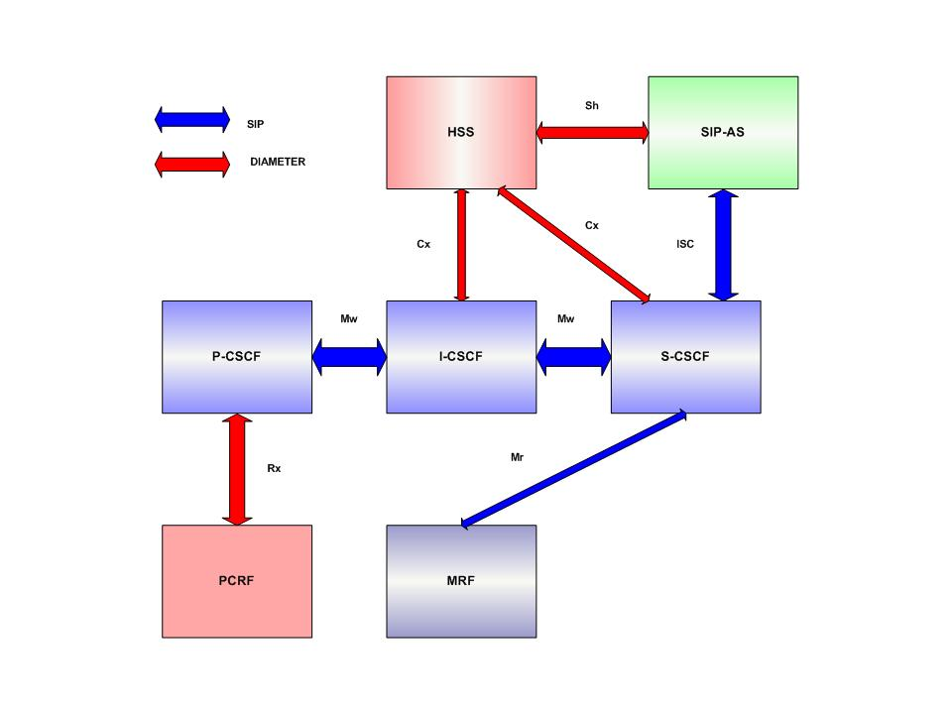

Slide 30
CSCf - call session control function
A serving-cscf (S-cscf)

Slide 31
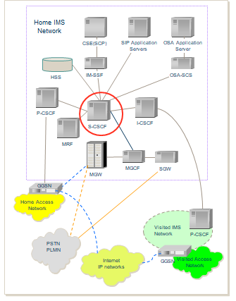
CSCf - call session control function
A Serving-CSCF (S-CSCF):
S-CSCF is SIP proxy, it is the central node of the IMS system
Mission:
Domain registration.
Session Control.
Store data service.
Notes:
S-CSCF is SIP proxy, it is the central node of the IMS system, responsible for domain registration, keep the session state and store data service.

Slide 32
CSCf - call session control function
A Serving-CSCF (S-CSCF):
The S-CSCF has access to all user data stored in HSS to user authentication.
Identifies the Application Server to provide to the user.
Provides SIP routing services.
S-CSCF is usually located in the home network
Notes:
The S-CSCF has access to all user data stored in HSS to get user information, user authentication.
Identifies the Application Server to provide to the user and notifiles for user from IMS system.
Provides SIP routing services and secure join the security in session creation.

Slide 34
Application server (AS)

Slide 35
Application server
What is Application Server (AS)?
The Application Server (AS) is a SIP entity that hosts and executes services.

Slide 36
Application server
Depending on the actual, AS can operate in:
SIP proxy mode
SIP UA (User Agent)
SIP B2BUA (Back-to-Back User Agent)

Slide 37
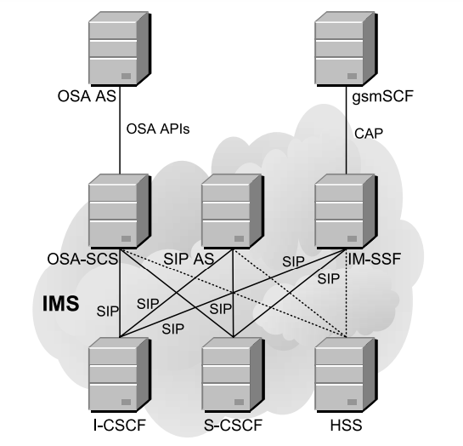
Application server
DIAMETER
SIP

Slide 38
Application server
How many types of AS?
There are 3 types of AS:
SIP AS
IM-SSF
OSA-SCS

Slide 39
SIP AS ( Application server)
This is the native AS
Host and executes IMS based on SIP
New IMS-specific services will probably be developed in SIP ASes.

Slide 40
OSA-SCS (Open Service Access–Service Capability Server).
Provides an interface to the OSA framework AS
Inherits all the OSA capabilities, especially the capability to access the IMS securely from external networks.

Slide 41
IM-SSF (IP Multimedia Service Switching Function).
Allows to reuse CAMEL (Customized Applications for Mobile network Enhanced Logic) services.
Allows a GSMSCF (GSM Service Control Function) to control an IMS session.
Acts as an AS on one side (interfacing the S-CSCF with SIP).
On the other side, it acts as an SSF (Service Switching Function).

Slide 42
AS Location
In the home network.
In an external third-party network to which the home.
if the AS is located outside the home network, it does not interface the HSS.

Slide 43
The mrf
Provides a source of media in the home network.
Provides the home network with the ability to play announcements, mix media streams, transcode between different codecs, obtain statistics, and do any sort of media analysis.

Slide 44
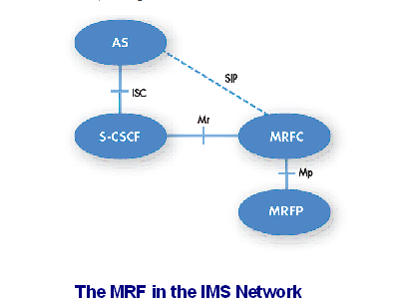
The mrf

Slide 45
The mrf
The MRF is further divided into:
MRFC (Media Resource Function Controller): a signaling plane node
Acts as a SIP User Agent and contains a SIP interface towards the S-CSCF.
Controls the resources in the MRFP via an H.248 interface.
MRFP (Media Resource Function Processor): a media plane node.
(The MRFC acts as a SIP User Agent and contains a SIP interface towards the S-CSCF. The MRFC controls the resources in the MRFP via an H.248 interface. The MRFP implements all the media-related functions, such as playing and mixing media.)

Slide 46
MRF location
The MRF is always located in the home network.

Slide 47

BGCF (Breakout Gateway Control Function)
Connect
SIP Server
Circuit switch domain

Slide 48


BGCF (Breakout Gateway Control Function)
CDT
Select appropriate
Generate CDTs
Interworking
network
PSTN/CS
Gateway
forward
Charging collection node

Slide 49
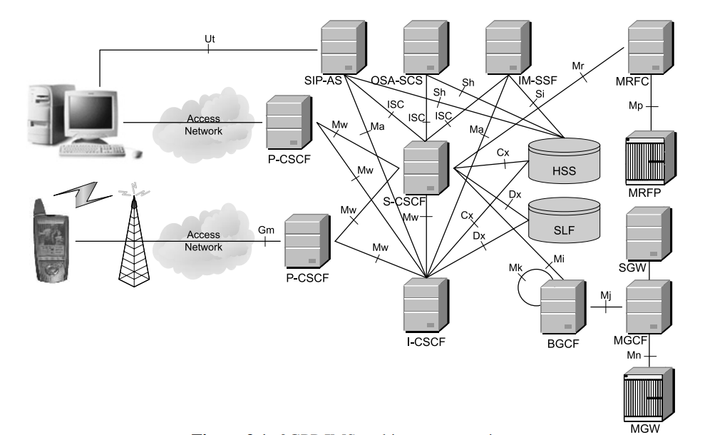
BGCF location

Slide 50
PSTN/CS (Public switched telephone network/Circuit Switched)
interface
interface
Interworking
network
PSTN/CS
Gateway
Circuit switch domain

Slide 51

SGW (Signaling gateway)
SCTP
Convert
Media Transfer Part
Stream Control Transmission Protocol

Slide 52
MGW (Media Gateway)
Connect
RTP
IMS
Media Plane
PSTN
Media Plane

Slide 53
MGCF (Media Gateway control function)
SIP
ISUP
BICC
Convert
Session Initial Protocol Signal
Signaling System 7
/Bearer Independent Call Control

Slide 54
MGCF (Media Gateway control function)
MGCF
Control
H.248
Media Gateway Control Function
MGW
Resource

Slide 55
Thank you for listening

